Slide 1
Cybertech SpiRItuality as Knowing God
Why a failed engineer followed a people ministry but ended up in cyber-technological entrapments
Many techies find little spiritual meaning in the endless singing of meaningless hymns. But start talking about technology and they come alive
Genesis 1:1-28

Slide 2

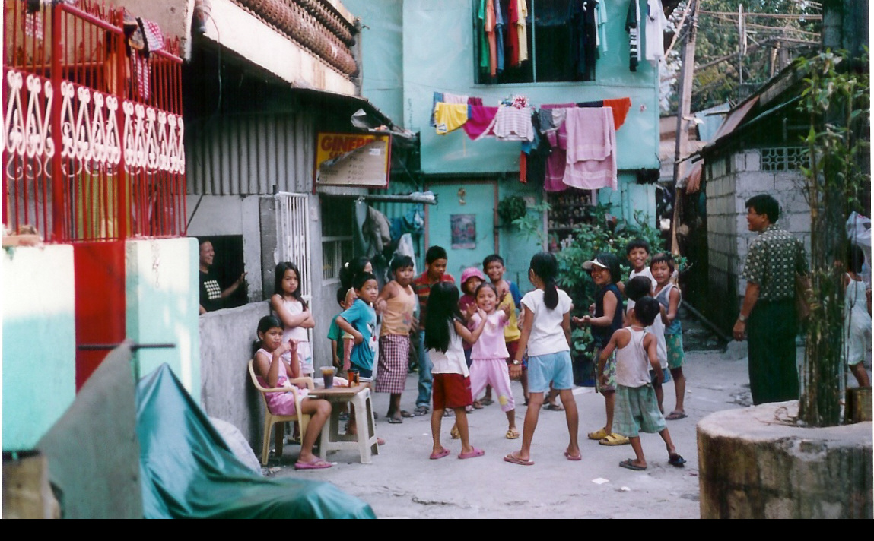
2 billion in slums - and technology?
Totally inadequate to lead an army
Catalyzing movements
Starting missions
Networking to 400,000

Slide 3
Before the Beginning: 3 in one
God was Love
The Spirit of Creation is more relevant than the Spirit of Emotion

Slide 4
Before the Beginning: God
Created
Love
Wireless microphones In Midst of Chaos
Technological education

Slide 5
Before the Beginning: God
Created
Love
Producer -entrepreneur
Technological God In Midst of Chaos
Entrepreneurship is more important than Innovation – teamwork of apostles, innovators, entrepreneurs

Slide 6
Before the Beginning: God
Created
Love
Producer –entrepreneur
Communicator
In Design of Communications is the Knowledge of God

Slide 7
God as Database Manager
3 days he created structure
3 days he filled in the content
Then he rested
You rest??
6 Years identifying 6600 least evangelized cities of over 100,000 and the .
Now 12,000.
Future of Mission in the Urban Millenium is Urban Poor

Slide 8
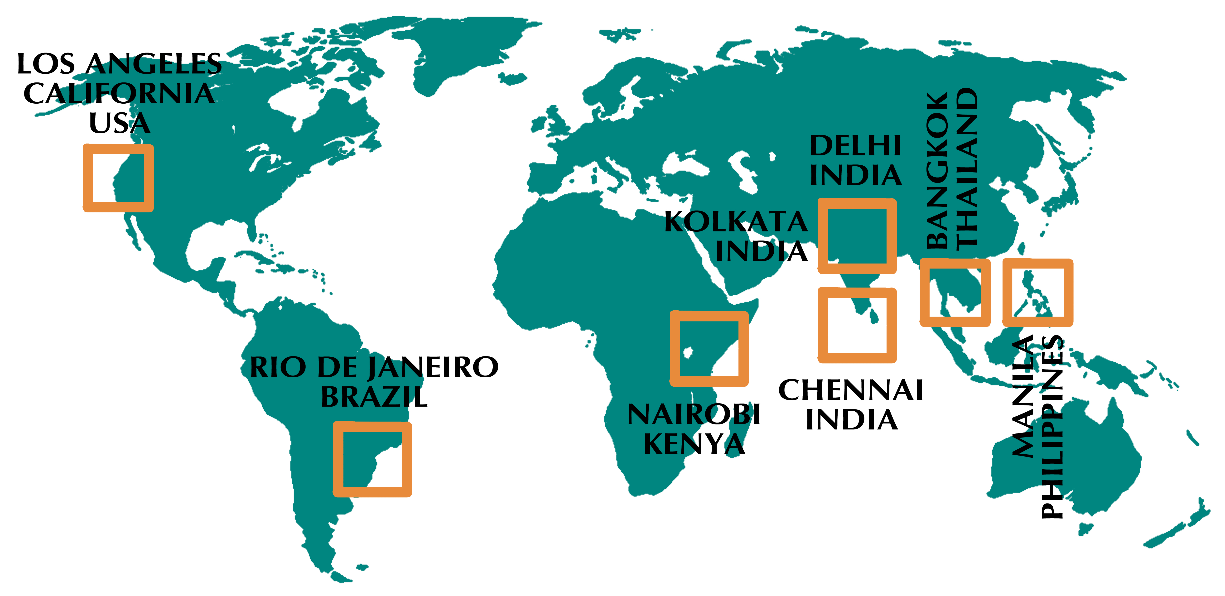
MA transformational urban leadership
www.matul.org
8 cities round globe each delivering program, 60 faculty, 15 resource websites
Online from Rio to students in slums of 8 cities

Slide 9
Grassroots Training to 100,000 SLUM leaders
5 levels of multiplication of 48 units/ 10 Certificates via CellPhone
Key is trainers at each level
Walk alongside the apostles
Let them manage the people raising
Take on the infrastructural design
Recruit workers

